Slide 1
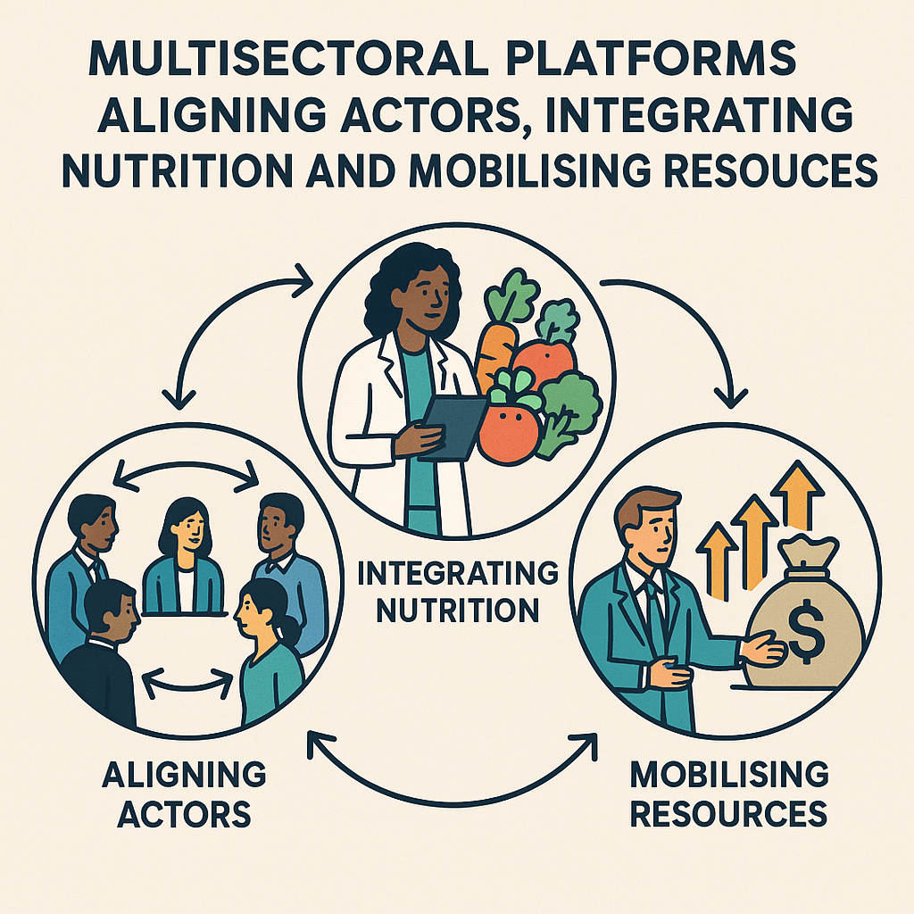

Light-Touch Leadership Coaching Support for the SUN Movement Secretariat- Liberia
Session 1- Team Reconnecting and the 3 Horizons Model
https://sparkhealthafrica.co.za
https://www.linkedin.com/company/sparkhealthafro

Slide 2
Welcome & Check-In
We’re glad that the the SUN Movement Secretariat- Liberia team is here. The purpose of today’s session is to:
Reconnect as a team.
Revisit and refine the vision for nutrition coordination in Liberia.
For us to to that, we’d like to share the next steps for the upcoming work.

Slide 3
Light-touch Leadership Support Program Overview
Our Journey Together: 4 Sessions over 8 Weeks
Format: 2 hours each session | Every two weeks | Highly interactive
Session | Title | Focus
1 | Revisiting the Vision | Three Horizons Framework & Visioning
2 | From Vision to Action | Strengthening Your MSP Action Plan
3 | Leading with Influence | Engaging Champions & Building Alliances
4 | Building a Cohesive Team Culture | Working Better Together

Slide 4
How This Program Works
This is NOT a typical training.
What This IS | What This IS NOT
Interactive and participatory | A lecture or presentation
Grounded in YOUR action plan | Generic, off-the-shelf content
Focused on real challenges | Theoretical or academic
Builds skills you can use immediately | A box-ticking exercise
Your commitment matters:
Attend all sessions.
Participate honestly.
Apply learning between sessions.

Slide 5
The outcomes we expect you to achieve
By the end of 4 sessions, you will have:
A shared Horizon 3 vision for nutrition coordination in Liberia.
A refined, team-owned MSP action plan with clear priorities and roles.
A practical champion engagement strategy for the Vice President’s Office and other key influencers.
A Team Charter with working agreements that help you collaborate effectively.
Today is about building the foundation: the vision.

Slide 6
Temperature check
But before we dive into the real work, please tell us how you are feeling about all this.
How are you feeling about this program?
What is one word to describe your current energy for this work?

Slide 7
An introduction to the 3 Horizons Model
Transformative Leadership: “The three horizons framework”
Session Objectives
By the end of the session, participants get:
Shared awareness of today’s reality
A bold future vision
Concrete ideas for innovations and transitions
And a practical action map with commitments

Slide 8
Setting the Stage

Slide 9
Transformative Leadership: “The three horizons framework”
Objective
Build a shared understanding of the Multi-Sectoral Platform context and current challenges
Introduction to the 3 Horizons Model

Slide 10
Transformative Leadership: “The three horizons framework”
Horizon 1: Today’s Reality (Business as Usual)
Horizon 2: Transition Zone (Innovation & Experiments)
Horizon 3: Future Vision (Transformative Change)
The 3 Horizons Model helps us understand how systems evolve over time, especially when they must transition from what is familiar to what is fundamentally new
Notes:
Any transformation agenda should be based on our current reality, then we paint a picture of the future we want. Then we come up with a pathway to move us to where want to be. 3 horizons helps us to understand how systems evolve over time

Slide 11
Transformative Leadership: “The three horizons framework”
Purpose of the 3 Horizons model
To develop a deeper understanding of an issue of interest (how MSPs are functioning and how they can function better) by creating a Three Horizon sense-making map of the specific issue in order to inspire the formulation of visionary action for innovation and transformation.
Enables decision-makers to embark on sense-making in order to move from a single horizon mindset (current situation; status quo; ‘this is how things are or done’) into the three horizons perspective of future possibilities

Slide 12
3 Horizons Model
Pattern
Business as usual – losing its relevance
H1
Innovation towards
a Viable future
Transition zone
H2
H3
What’s working –
worth preserving
Time

Slide 13
3 Horizons Model
First Horizon (H1) – Current situation; current context; current conditions. The First Horizon is about maintaining the status quo; its about maintaining stability. The manager mindset dominates the First Horizon (routines, norms, same and familiar rules, stability).
Third Horizon (H3) – Big ideas about future possibilities; a transformative agenda; inspiring visions of possible futures. The Third Horizon is about transformation and disruption as opposed to incremental changes. The visionary mindset dominates the Third Horizon (innovative ideas, new paradigms, new possibilities and new rules, a break from the past).
Second Horizon (H2) – Present innovations and actions aimed at adapting to change; creating and leveraging new ideas to propel towards new ways of doing things. The entrepreneur mindset dominates the Second Horizon (responding to the external environment by creating and managing change; innovating to manage constraints)

Slide 14
3 Horizons Model
Pattern
H1
H2-
Tension
H2+
Transition zone
H2
H3
Time

Slide 15
3 Horizons Questions: Group Activity Questions
H1 | H3 | H2
What is business as usual regarding MSP in our country? (Assumptions taken for granted by the government, funders and implementing partners as exhibited by “this is how things are done here” mentality) How did we get in this situation? (Belief systems, values, norms) Is there anything about the current MSP situation that is valuable and therefore worth preserving? | Imagine it’s 2035 and your MSP is celebrated globally as a model of alignment and integration. What does it look like? How does it function? What has changed in culture and leadership? What values and norms would support the future of the MSP that you envisage? What examples do you know about where elements of the future of this MSP you have described already exist? (Seeds of hope) How can such seeds of hope be scaled and spread? | What innovations do you know about that are responding to the pressures for change which might be growth points of the future MPS that you want? Which of these innovations hold better promise for a responsive and fit-for-purpose MSP of the future? How can such innovations be used to create pathways to transition into the envisaged future MSP?

Slide 16
Transformative Leadership: “The three horizons framework”
H1 - Today’s Reality (Business as Usual)
Objective
To understand and map the current reality in our MSPs

Slide 17
Transformative Leadership: “The three horizons framework”
H1 - Today’s Reality (Business as Usual)
Group Activity 1: Horizon 1
Purpose: Surface the entrenched problems, assumptions, behaviours, and system patterns that hold the MSP in its current state.
Output: A clear map of current barriers and limiting mental models.

Slide 18
Group Activity 1: What does our MSP look like today?
H1 | H3 | H2
What is business as usual regarding MSP in our country? (Assumptions taken for granted by the government, funders and implementing partners as exhibited by “this is how things are done here” mentality) How did we get in this situation? (Belief systems, values, norms) Is there anything about our current MSP that is valuable and therefore worth preserving? | What nutrition financing future do we want? What values and norms would support the future of nutrition financing that you envisage? What examples do you know about where elements of the future of nutrition financing you have described already exist? (Seeds of hope) How can such seeds of hope be scaled and spread? | What innovations do you know about that are responding to the pressures for change which might be growth points of the future of nutrition financing? Which of these innovations hold better promise for a responsive and fit-for-purpose nutrition financing system of the future? How can such innovations be used to create pathways to transition into the envisaged future of nutrition financing?

Slide 19
3 Horizons Model: Today’s Reality (Business as Usual)
Step 1 (a). What is evident about the failures of our current MSP, given the needs and aspirations of our country?
How did we get here?
Pattern
H1
H2
Step 1 (b). What elements of our current MSP are valuable and therefore worth preserving?
H3
Time

Slide 20
Group Activity 1: Horizon 1 – Today’s Reality Activity Questions
SECTION A — Current System Performance
What is not working well in our MSP today?
  (coordination, leadership, accountability, resource mobilisation, data sharing, participation)
Where do we consistently experience breakdowns or bottlenecks?
  Planning?
  Implementation?
  Follow-through?
  Communication?
What examples demonstrate that our MSP is stuck in “business as usual”?
SECTION B — Current Assumptions, Mindsets & Behaviours
What assumptions underpin how we currently work together across sectors?
  (e.g., “finance will not prioritise nutrition”, “each sector should work alone”, “data belongs to the ministry that collects it”)
Which of these assumptions are limiting our ability to improve nutrition outcomes?
What behaviours or attitudes prevent effective multisectoral collaboration?
  Defensiveness
  Sector competition
  Hierarchical decision-making
  Weak ownership
SECTION C — Current Resource & Capability Gaps
Where do we lack the resources needed to act effectively?
  Funding
  Human resources
  Technical capacity
  Data systems
  Leadership skills
Which coordination or governance structures are weak or missing?
SECTION D — Leverage Points Hidden in Today’s Reality
What is working today, even in a small way, that we could build upon?
  (existing partnerships, champions, policies, community structures)
Where is there untapped potential in the system that is not being used?
  (private sector, youth, religious organisations, local leaders, agriculture extension, digital tools)

Slide 21
Transformative Leadership: “The three horizons framework”
Horizon 3- Future Vision & Transformative Change

Slide 22
Transformative Leadership: “The three horizons framework”
Horizon 3 - Future Vision & Transformative Change
Objective
Envision what a fully functional MSP could look like in 10 years

Slide 23
Group Activity 2: “It’s 2030, our MSP has transformed. What does success look like?”
H1 | H3 | H2
What is business as usual regarding nutrition financing in your country/region? (Assumptions taken for granted by governments, funders and implementing partners – this is how things are done; assumed will always be there) How did we get in this situation? (Belief systems, values, norms) Is there anything about the current situation that is valuable and therefore worth preserving? | Imagine it’s 2035 and your MSP is celebrated globally as a model of alignment and integration. What does it look like? How does it function? What has changed in our culture and leadership? What values and norms would support the future of the MSP that you envisage? What examples do you know about where elements of the future of the MSP you have described already exist? (Seeds of hope) How can such seeds of hope be scaled and spread? | What innovations do you know about that are responding to the pressures for change which might be growth points of the future of nutrition financing? Which of these innovations hold better promise for a responsive and fit-for-purpose nutrition financing system of the future? How can such innovations be used to create pathways to transition into the envisaged future of nutrition financing?

Slide 24
3 Horizons Model: H3 Future Vision (Transformative Change)
Step 2 (a). What visions do we have for the future MSP we want?
What trends are gathering momentum towards the future MSP that we want?
Pattern
H1
H2
Step 2 (b). What are the seeds of hope that we can see in the current MSP and elsewhere?
H3
Time

Slide 25
Transformative Leadership: “The three horizons framework”
H3 - Future Vision - Transformative Change
Group Activity 2: Horizon 3
Purpose: Build a bold, shared vision of a fully transformed MSP in 2035.
Output: Future-ready design principles to guide long-term system transformation.

Slide 26
Group Activity 2: Horizon 3 – Future Vision Activity Questions
SECTION A — Future System Performance
Imagine it is 2035 and our MSP is a success story.
What does high performance look like?
Coordination
Resource mobilisation
Data-driven action
Equity
Partnership effectiveness
How do sectors work together in this future?
  (joint planning, integrated budgets, shared dashboards, cross-sector teams)
SECTION B — Future Culture, Leadership & Behaviours
What leadership culture exists in 2035?
Shared accountability
Trust
Adaptive leadership
Transparency
Collaboration across hierarchy
What mindsets define the MSP in 2035?
(e.g., “nutrition is everyone’s responsibility”, “we succeed when we act together”, “data belongs to the system”)
What behaviours enable consistent follow-through and results?
SECTION C — Future Structures, Processes & Financing
What future governance structures make alignment effortless?
A dedicated coordination unit?
Joint budgeting mechanisms?
Inter-ministerial delivery platforms?
District/County-level decision autonomy?
What does sustainable financing look like in 2035?
Pooled funds
Innovative health/nutrition levies
Private sector co-investment
Domestic resource mobilization
How is data used in 2035?
Real-time dashboards
Predictive analytics
Community feedback loops
SECTION D — Future Impact & Equity
Who benefits the most in this future system—and how do you know?
(children, adolescents, women, rural households, vulnerable groups)
What measurable improvements define success in 2035?
Stunting reduction
Coverage of key interventions
Financial protection
Access to services
Cross-sector responsiveness
SECTION E — Backcasting (Connecting H3 to H2)
NB. To be done after Horizon 2 mapping
What must be true 10 years earlier (2025–2026) for this future to exist?
Which Horizon 2 innovations identified earlier are essential to enable this future?

Slide 27
Transformative Leadership: “The three horizons framework”
Horizon 2 - Emerging Innovations & Transition Zone

Slide 28
Transformative Leadership: “The three horizons framework”
Emerging Innovations & Transition Zone
Objective
Identify practical innovations and transitional actions that could shift the MSP system

Slide 29
Group Activity 3: Which innovations hold the most promise regarding the future MSP?
H1 | H3 | H2
What is business as usual regarding nutrition financing in your country/region? (Assumptions taken for granted by governments, funders and implementing partners – this is how things are done; assumed will always be there) How did we get in this situation? (Belief systems, values, norms) Is there anything about the current situation that is valuable and therefore worth preserving? | What nutrition financing future do we want? What values and norms would support the future of nutrition financing that you envisage? What examples do you know about where elements of the future of nutrition financing you have described already exist? (Seeds of hope) How can such seeds of hope be scaled and spread? | What innovations do you know about that are responding to the pressures for change which might be change pathways for the future MPS that you want? Which of these innovations hold better promise for a responsive and fit-for-purpose MSP of the future? How can such innovations be used to create pathways to transition into the envisaged future MSP?

Slide 30
3 Horizons Model: H2 Transition Zone (Innovation & Experiments)
Pattern
Step 3. What innovations do you know of that could be leveraged as change pathways for the future MSP you want?
H1
H2
H3
Time

Slide 31
Transformative Leadership: “The three horizons framework”
H2 - Emerging Innovations & Transition Zone
Group Activity 3: Horizon 2
Purpose: Help participants identify transitional innovations, challenge existing assumptions, and explore emerging possibilities using Horizon 2 thinking.
Output from Group Activity 3
A set of clearly articulated Horizon 2 innovations
A shared understanding of which current assumptions need to shift
Identification of new models, partners, and underserved populations
A good perspective for connecting Horizon 1 to Horizon 3

Slide 32
Group Activity 3: Horizon 2 – Transitional Innovations Activity Questions
SECTION A — Challenging Current Assumptions
These questions help participants surface the “rules” and assumptions that limit today’s MSP performance.
Which current assumptions about how the MSP works will be most challenged as new ways of working emerge?
  Examples: assumptions about sector silos, budgeting processes, who leads coordination, data ownership, etc.
Which existing practices are most vulnerable to emerging changes (new policies, technologies, community expectations, funding streams)?
Are there any current assumptions that are actually being strengthened by emerging trends?
Pick one strengthened assumption and briefly explain why it will become stronger due to emerging trends.
SECTION B — Reimagining Possibilities in Horizon 2
Use these questions to think beyond incremental improvements and explore new options.
How could the emerging changes (e.g., digital tools, new funding mechanisms, stronger community voice, political momentum) enable entirely new ways of delivering nutrition services?
  New coordination processes
  New multisectoral linkages
  New service models
Is there an alternative model for running the MSP that could replace or complement the current model?
Examples:
  A rotating chair model
  A joint-planning & budgeting unit
  An MSP hosted in a neutral coordination office
  Community-led monitoring
SECTION C — Exploring New System Configurations
What new or emerging partnerships could reshape the nutrition ecosystem?
  Private sector?
  Social protection programs?
  Agriculture extension?
  Youth groups?
  Religious and traditional leaders?
Are there new production or service delivery processes we could test (e.g., integrated outreach, bundled services, cross-sector dashboards)?
What new, previously underserved groups (“emerging customer segments”) could be reached through Horizon 2 innovations?
  Adolescent mothers
  Young fathers
  Informal workers
  Remote rural communities
  Refugees or migrants

Slide 33
Transformative Leadership: “The three horizons framework”
The 3 Horizons - Connecting Horizons & Making Commitments

Slide 34
Transformative Leadership: “The three horizons framework”
The 3 Horizons - Connecting Horizons & Making Commitments
Objectives
To help participants link:
Horizon 1: Today’s reality (current barriers, systemic patterns, limiting assumptions)
Horizon 2: Transitional innovations (emerging possibilities, pilots, new partnerships, shifts in assumptions)
Horizon 3: A bold future vision (transformed MSP culture, structures, financing, leadership, and accountability)
After linking the horizons, the objective is to turn these into a coherent roadmap with practical commitments.

Slide 35
The 3 Horizons - Connecting Horizons & Making Commitments
Step 1 (a). What is evident about the failures of our current MSP, given the needs and aspirations of our country?
How did we get here?
Step 3. What innovations do you know of that could be leveraged as change pathways for the future MSP you want?
Step 2 (a). What visions do we have for the future MSP we want?
What trends are gathering momentum towards the future MSP that we want?
Pattern
H1
H2
Step 2 (b). What are the seeds of hope that we can see in the current MSP?
Step 1 (b). What elements of our current MSP are valuable and therefore worth preserving?
H3
Time

Slide 36
The 3 Horizons - Connecting Horizons & Commitments
Step 1: Horizon 1 (ground reality)
What is holding us back today?
Output: A clear, honest picture of entrenched barriers plus what is working that is worth preserving
Step 2: Horizon 3 (Future vision)
What does MSP excellence look like in 2035?
Output: A bold, shared MSP future vision
Step 3: Horizon 2 (Innovations and Transitional zone)
What transitional innovations can move us forward?
Output: A portfolio of possible innovation pathways that bridge H1 and H3

Slide 37
Transformative Leadership: “The three horizons framework”
The 3 Horizons - Connecting Horizons & Commitments
Groups now build the 3 Horizons Pathway Map using their previous outputs to tell a story.
H3 → H1 → H2 Pathway Building Steps
Start from H3: Identify future state anchor conditions
Return to H1: Identify which H1 barriers must be removed/reduced to make H3 possible
Move to H2: Identify which transitional innovations will enable those H3 conditions

Slide 38
Discussion

